Slide 1
Diabetes Binary Classification using Various Machine Learning Algorithms
ECE 5400
Final Project
Ahmed Abdelgalil & Dagmawe Legesse

Slide 2

Agenda
Dataset & Motivation
Exploratory Data Analysis (EDA)
Classifiers
MLP Implementation
Evaluations & Results
What We Learned
Future Improvements
Questions

Slide 3
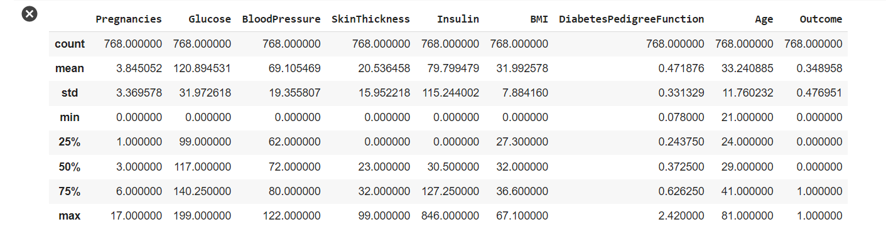
Dataset & Motivation
Classification task
Healthcare application
Domain knowledge
Notes:
Looked for a classification task rather than a regression task since we find them to be more interesting
ML has many application and personally I am interested in its application to finance & healthcare however, this dataset seemed to be more interesting
We have some domain knowledge in what diabetes is and believed it would be good to have an even better understanding

Slide 4
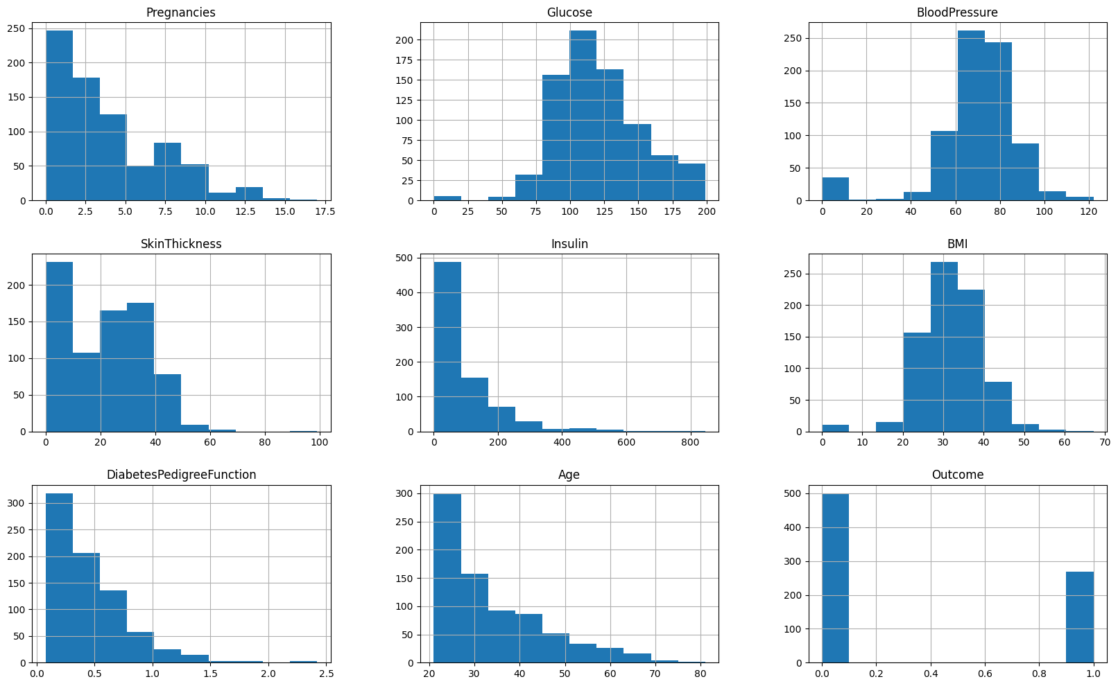
Exploratory Data Analysis (EDA)
Histograms

Slide 5
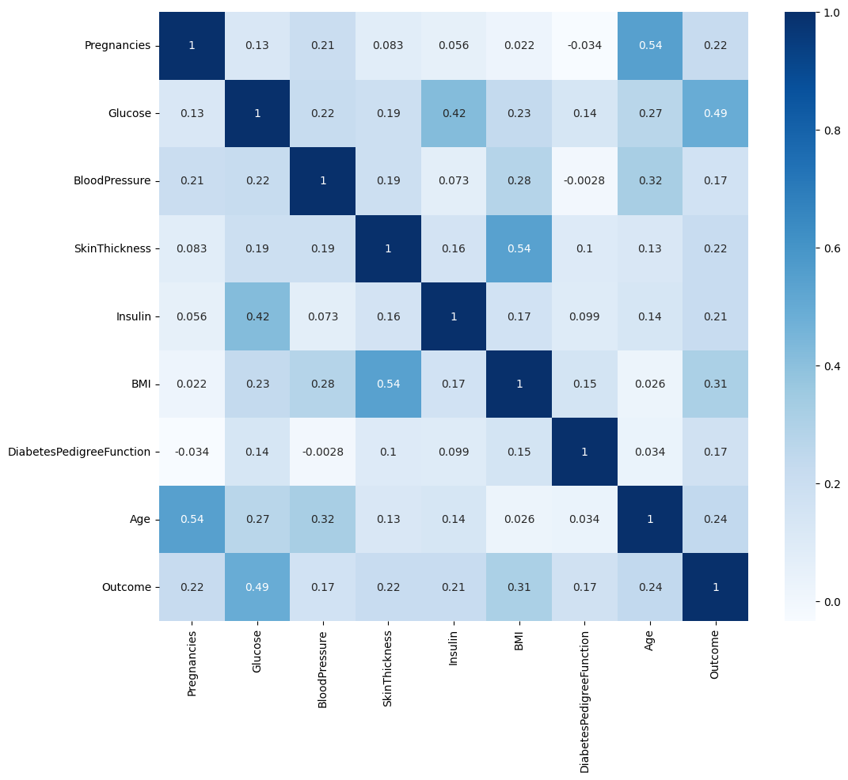
Exploratory Data Analysis (EDA)
Correlations

Slide 6
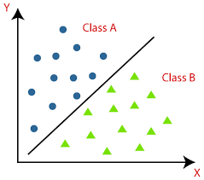
Classifiers
Logistic Regression
Decision Tree
Random Forest
Multilayer Perceptron Neural Network

Slide 7
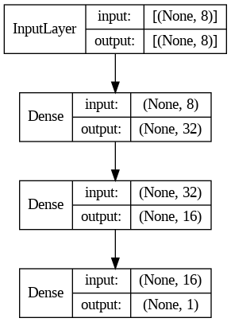
MLP Architecture
Input layer
8 features
Two hidden layers (Dense layers)
32 neurons
16 neurons
Output layer (Dense layer)
1 (binary)
Activations
ReLU
Sigmoid

Slide 8
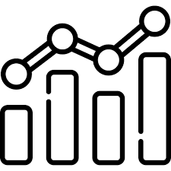
Evaluation
Accuracy
Precision
Recall
F1 Score

Slide 9
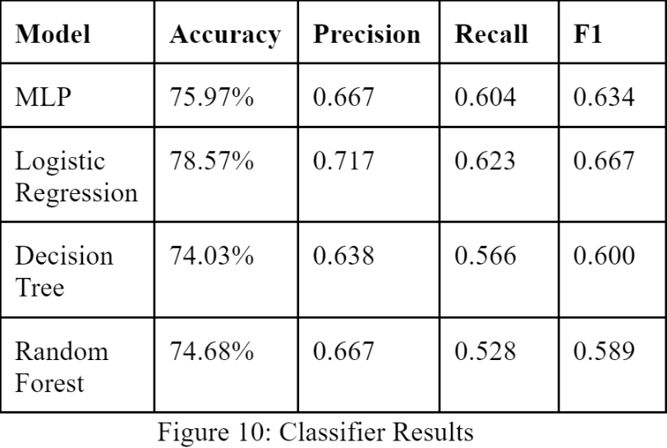
Results

Slide 10
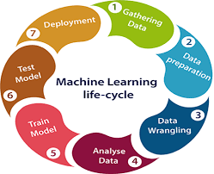
What We Learned
Machine Learning life-cycle
Importance of domain knowledge
EDA techniques & libraries
Seaborn
Matplotlib
Notes:
ML life cycle
Importance of doing your research on the dataset and understanding what is contained in it
EDA techniques and plots which we used in creating the histograms and correlation plot. Also, for other plots we had in our curve like confusion matrix, recall curve, and ROC curve

Slide 11

Future Improvements
Feature engineering
Larger dataset
Oversampling?
Balanced dataset
768 total samples
500 negative
268 positive
Imblearn library
Notes:
Feature engineering to create more features for our dataset through more data analysis - creating features from existing datasets
The dataset only has a total of 768 samples, a larger dataset would allow us to have a more reliable and accurate model. We can potentially accomplish this through oversampling and possibly generating data
The dataset was imbalanced, there were twice as many negative cases as there were positive cases. Next step would be to balance the dataset

Slide 12
Questions?

